Slide 1
Comparison and Analysis of the Impact of PCA on Decision Tree Classification
CS831-Knowledge Discovery in Database
Peizhi Han
Yixing Chen
November 26th, 2019

Slide 2
Content
1. Introduction
- 1.1. Objective
- 1.2. Process and method
- 1.3. Tools and data sets
2. Implementation
- 2.1. Data Selection
- 2.2. Data Preprocessing and transformation
- 2.3. Data Mining
- 2.4. Testing and Evaluation
- 2.5. Results and Discussion
3. Conclusion
4. Future Improvement
2

Slide 3
1. Introduction

Slide 4
1.1. Objective
Based on three different databases and using decision tree as classifier:
Find the impact of principal component analysis (PCA) on decision tree classification;
Get two principal components by PCA, then try every combination of two attributes from the data set, find which way could better predict the classification result.
4

Slide 5
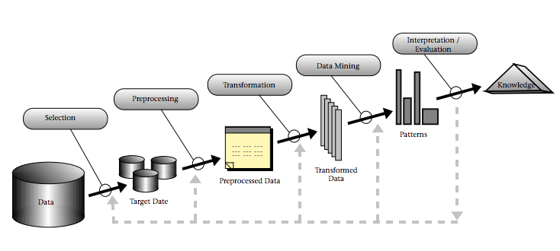
1.2. Process and Method
An overview of the steps that compose the KDD process [1]:
5

Slide 6
1.3. Tools and data sets
Three data sets from UCI Machine Learning data repository: heart disease [2], breast cancer [3], and default of credit card clients [4].
Programming language and tools: Google Colaboratory with Python and Orange 3 Toolkit.
6

Slide 7
2. Implementation

Slide 8
2.1. Data Selection
Three data sets from UCI Machine Learning data repository:
Heart Disease Data Set: 14 attributes and 303 instances
Breast Cancer Wisconsin (Diagnostic) Data Set: 31 attributes and 569 instances
Default of credit card clients Data Set: 24 attributes and 30,000 instances
8

Slide 9
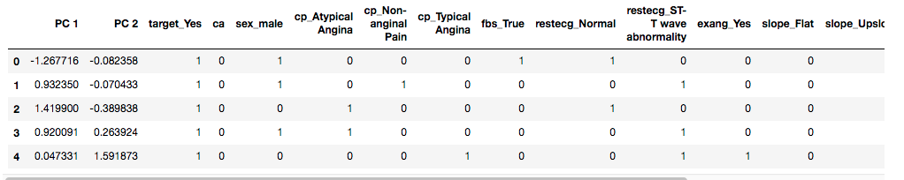
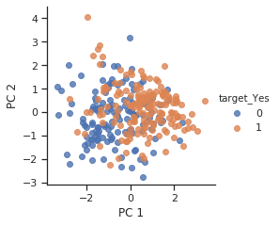
2.2.1. Data Preprocessing and Transformation-Heart Disease Data Set
Handle missing values.
Five numerical variables and seven categorical variables. Hence, we use Dummy Variables to transform all categorical data into numerical data.
Preprocess with PCA:
Use PCA to reduce the dimension of numerical data into two dimensions, then generate a new data set:
Plot correlation between the two principal components:
9

Slide 10
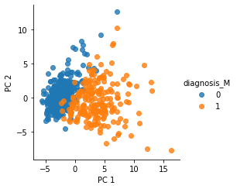
2.2.2. Data Preprocessing and Transformation-Breast Cancer Wisconsin (Diagnostic) Data Set
Handle missing values.
All attributes are all numerical.
Apply PCA on all attributes then reduce the attributes into two dimensions.
Plot correlation between the two principal components:
Preprocess with PCA:
10

Slide 11
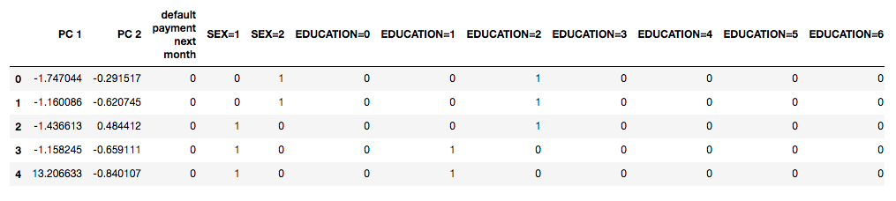
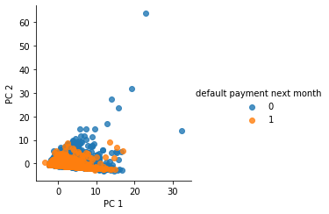
2.2.3. Data Preprocessing and Transformation-Default of Credit Card Clients Data Set
Handle missing values
14 numerical variables and ten categorical variables, hence, we use Dummy Variables to transform all categorical data into numerical data
Preprocess with PCA:
Use PCA to reduce the dimension of numerical data into two dimensions, then generate a new data set:
Plot correlation between the two principal components:
11

Slide 12
2.3. Data Mining
Classification algorithm:
Decision Tree with both Gini and information gain as criterions.
12

Slide 13
2.4.Testing and Evaluation
Split training data and testing data as 80% and 20%.
PCA approach
Non PCA approach:
Find all combinations of two attributes among all of the attributes, calculate the prediction accuracy of each combination.
Compare all accuracies, find the group with the highest accuracy rate.

Slide 14
2.4.Testing and Evaluation (continued)
Accuracy Matrix:
Measure- ment Data Set | PCA |  | NON PCA
 | Gini | Information Gain | Gini |  | Information Gain
 |  |  | All Attributes | Highest Two Attributes | All Attributes | Highest Two Attributes
Heart Disease | 77.0% | 75.4% | 75.4% | 86.9% | 78.6% | 86.9%
Breast Cancer | 88.6% | 86.8% | 90.4% | 94.7% | 87.7% | 94.7%
Credit Card | 79.5% | 80.0% | 79.2% | 87.5% | 78.1% | 87.5%

Slide 15
2.4.Testing and Evaluation (continued)
Breast Cancer Wisconsin Data Set: 31 attributes
30 choose 2 = 435 combinations
0 [0, 1] Feature: radius_mean + texture_mean Testset accuracy: 85.09%
1 [0, 2] Feature: radius_mean + perimeter_mean Testset accuracy: 86.84%
… …
54 [1, 27] Feature: texture_mean + concave points_worst Testset accuracy: 94.74%
… …
434 [28, 29] Feature: symmetry_worst + fractal_dimension_worst Testset accuracy: 62.28%

Slide 16
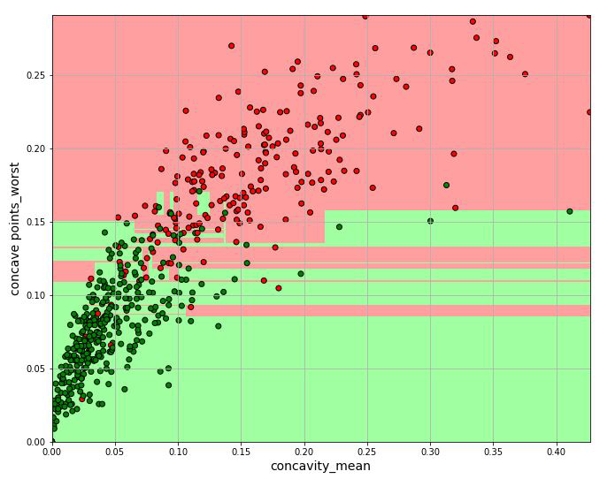
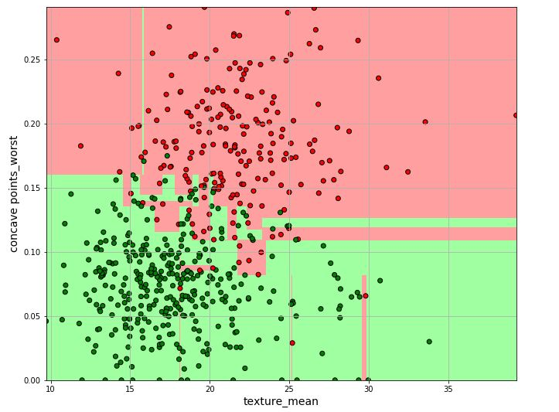
2.4.Testing and Evaluation (continued)
Breast Cancer-the highest two attributes correlation (Gini and information gain):
179 [6, 27] Feature: concavity_mean + concave points_worst Testset accuracy: 94.74%
54 [1, 27] Feature: texture_mean + concave points_worst Testset accuracy: 94.74%
1 - Malignant
1 - Malignant
0 - Benign
0 - Benign

Slide 17
2.5. Results and Discussion
In Heart Disease data set, the accuracy of PCA approach and Non-PCA approach is quite close.
In Breast Cancer data set, non-PCA approach has accuracy slightly higher than PCA approach.
In Credit Card data set, the accuracies are almost the same.
Among all three data sets, the approaches with only two attributes have the highest accuracy rates.
Measure- ment Data Set | PCA |  | NON PCA
 | Gini | Information Gain | Gini |  | Information Gain
 |  |  | All Attributes | Highest Two Attributes | All Attributes | Highest Two Attributes
Heart Disease | 77.0% | 75.4% | 75.4% | 86.9% | 78.6% | 86.9%
Breast Cancer | 88.6% | 86.8% | 90.4% | 94.7% | 87.7% | 94.7%
Credit Card | 79.5% | 80.0% | 79.2% | 87.5% | 78.1% | 87.5%

Slide 18
3. Conclusion
PCA is not a data preprocessing method that could improve the accuracy of all data sets.
In this research, using the most influential attributes from the original data can make better predictions than principal components.
For some cases, Gini and information gain do not have significant differences in the accuracy.
For a data set with all numerical variables, PCA could have a better performance than the data sets with both numerical and categorical variables.
18

Slide 19
4. Future Improvement
More comparison with:
Different sizes of data sets and other classification methods, such as Random Forest.
Different dimensions, such as three principal components and three attributes.
Deeper investigation:
Use statistical methods to verify if the data sets are Gaussian distribution data set, since under non-Gaussian distribution data, PCA may not make much difference.
Comparison between PCA and Factor Analysis.
19

Slide 20
References
[1] Fayyad, Piatetsky-Shapiro, Smyth, “From Data Mining to Knowledge Discovery: An Overview", in Fayyad, Piatetsky-Shapiro, Smyth, Uthurusamy, Advances in Knowledge Discovery and Data Mining, AAAI Press / The MIT Press, Menlo Park, CA, 1996,
[2] Archive.ics.uci.edu. (n.d.). UCI Machine Learning Repository: Heart Disease Data Set. [online] Available at: https://archive.ics.uci.edu/ml/datasets/Heart+Disease [Accessed 24 Nov. 2019].
[3] Archive.ics.uci.edu. (n.d.). UCI Machine Learning Repository: Breast Cancer Wisconsin (Diagnostic) Data Set. [online] Available at: https://archive.ics.uci.edu/ml/datasets/Breast+Cancer+Wisconsin+(Diagnostic) [Accessed 24 Nov. 2019].
[4] Archive.ics.uci.edu. (n.d.). UCI Machine Learning Repository: default of credit card clients Data Set. [online] Available at: https://archive.ics.uci.edu/ml/datasets/default+of+credit+card+clients [Accessed 24 Nov. 2019].
20

Slide 21
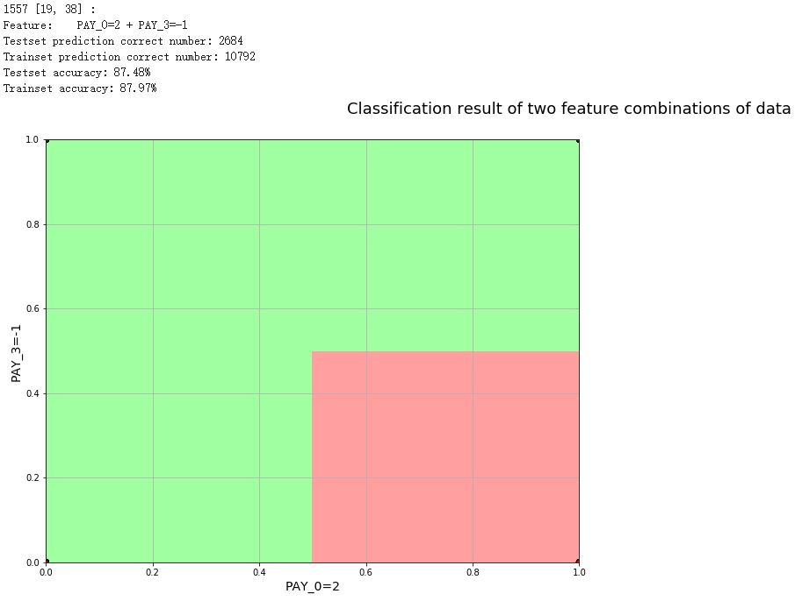
Appendix 1.1
Credit Card-the highest two attributes correlation (Gini):
1 - Yes
0 - No

Slide 22
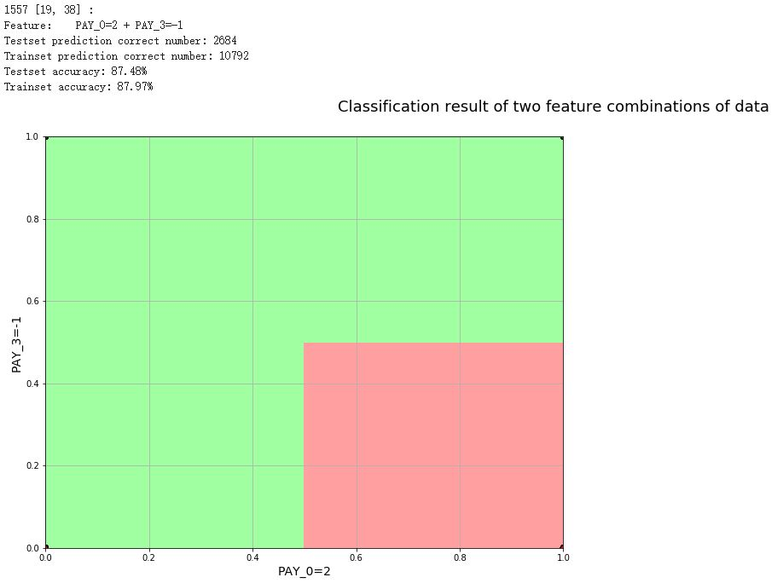
Appendix 1.2
Credit Card-the highest two attributes correlation (Information gain):
1 - Yes
0 - No

Slide 23
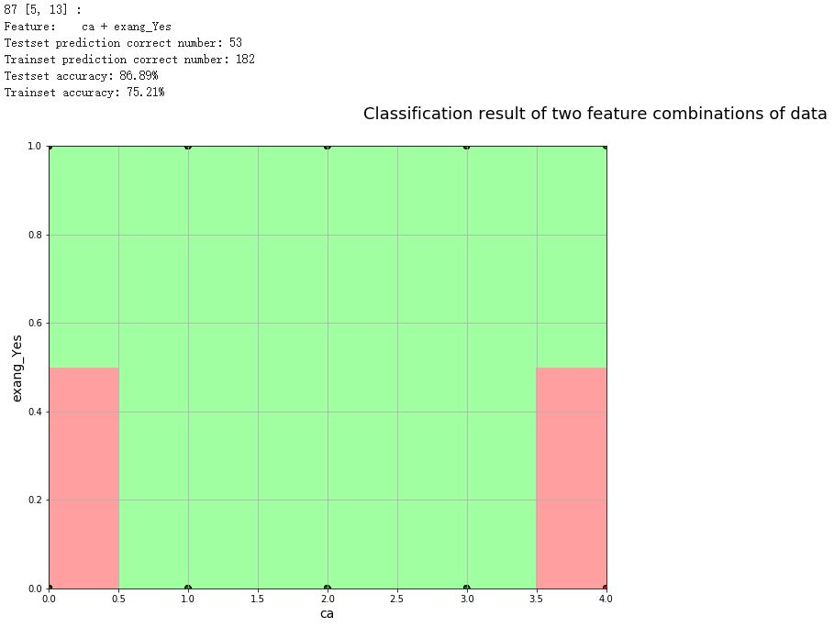
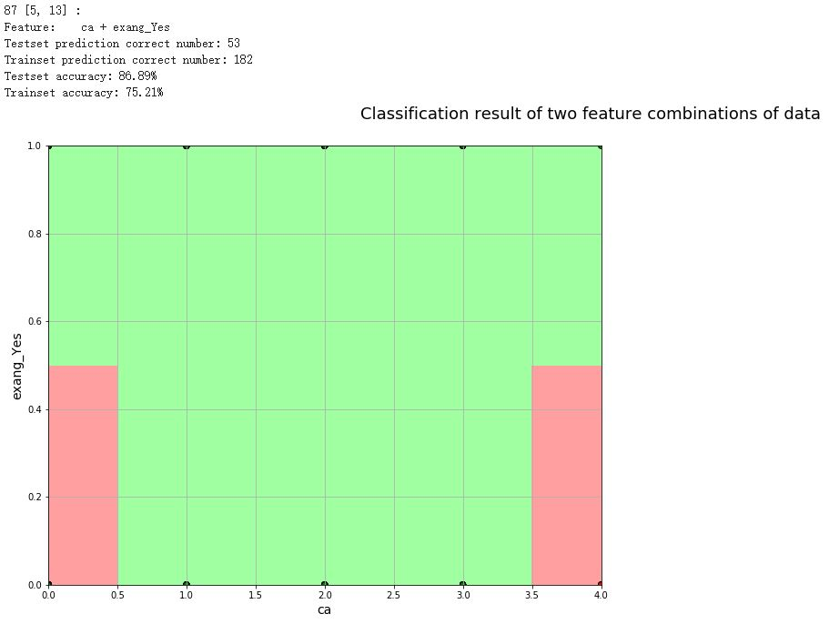
Appendix 2
Heart Disease -the highest two attributes correlation (Gini and information gain):
1 – Disease
1 – Disease
0 – No Disease
0 – No Disease

Slide 24
Thank you!
Any questions?
24

